Slide 1
Case Study 2
Team Members:
Robert Ašvicas
Dmitry Lvov
Project Tutor:
Mikaeil Shaghelani
2020,
The Netherlands

Slide 2
Shortly about us
We are small team of 2 friends
Dima (full name Dmitry) – 22 years old Russian, who was also studying in Panama. Loves IT, especially cyber-security.
Robert – 19 years old Lithuanian. Went to Fontys right after school. Loves IT as well, especially programming and connecting.

Slide 3
Project background briefly
The company “Make IT Work4U” is realizing improved infrastructure for its business clients. Our job is to make that simulated environment!

Slide 4
Minimal requirements
Virtual Servers to simulate environment
Application/dashboard is used to monitor servers
VPN connection
Different users and group policies in simulated environment
Backup policies

Slide 5
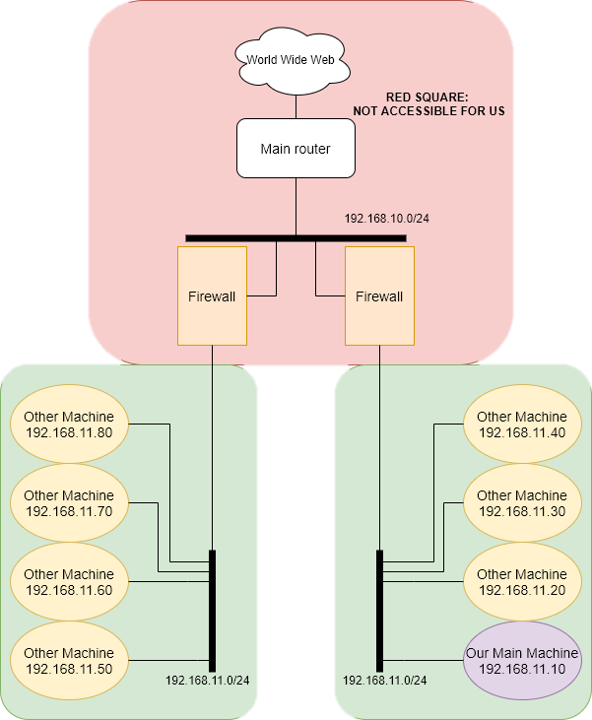
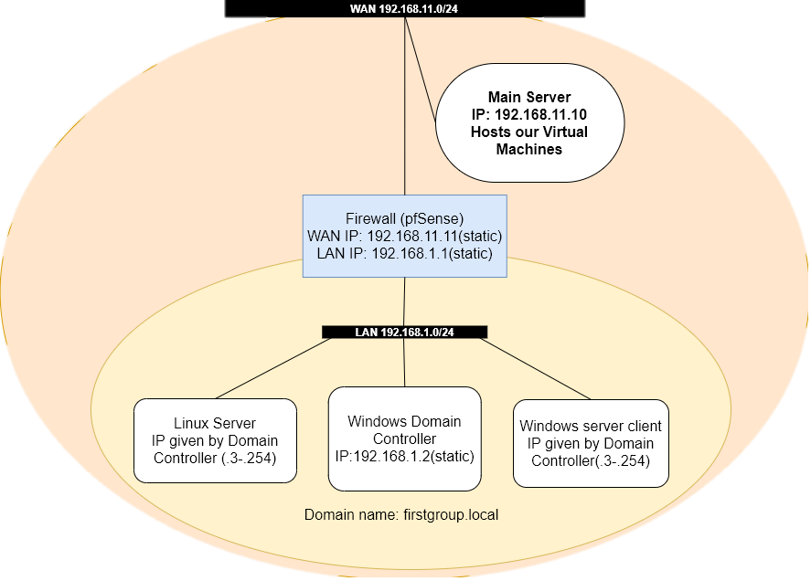
The infrastructure of the environment
Infrastructure of the whole server where our machine is hosted
Infrastructure of our machine

Slide 6
Virtual machines
Windows AD
Windows client
Linux
Firewall

Slide 7
Windows Active Directory
Has several purposes:
DNS server
DHCP server
Folder redirection
Group Policies

Slide 8
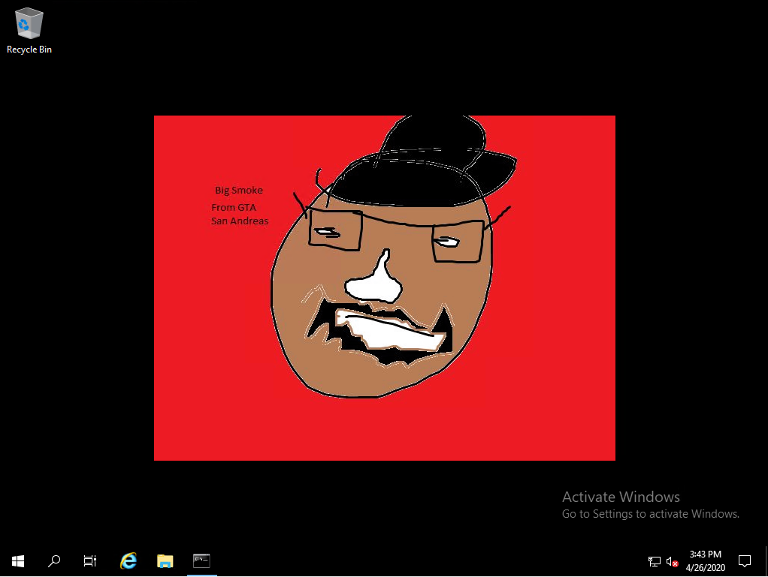
Windows client
Serves only as a machine that client can connect to

Slide 9
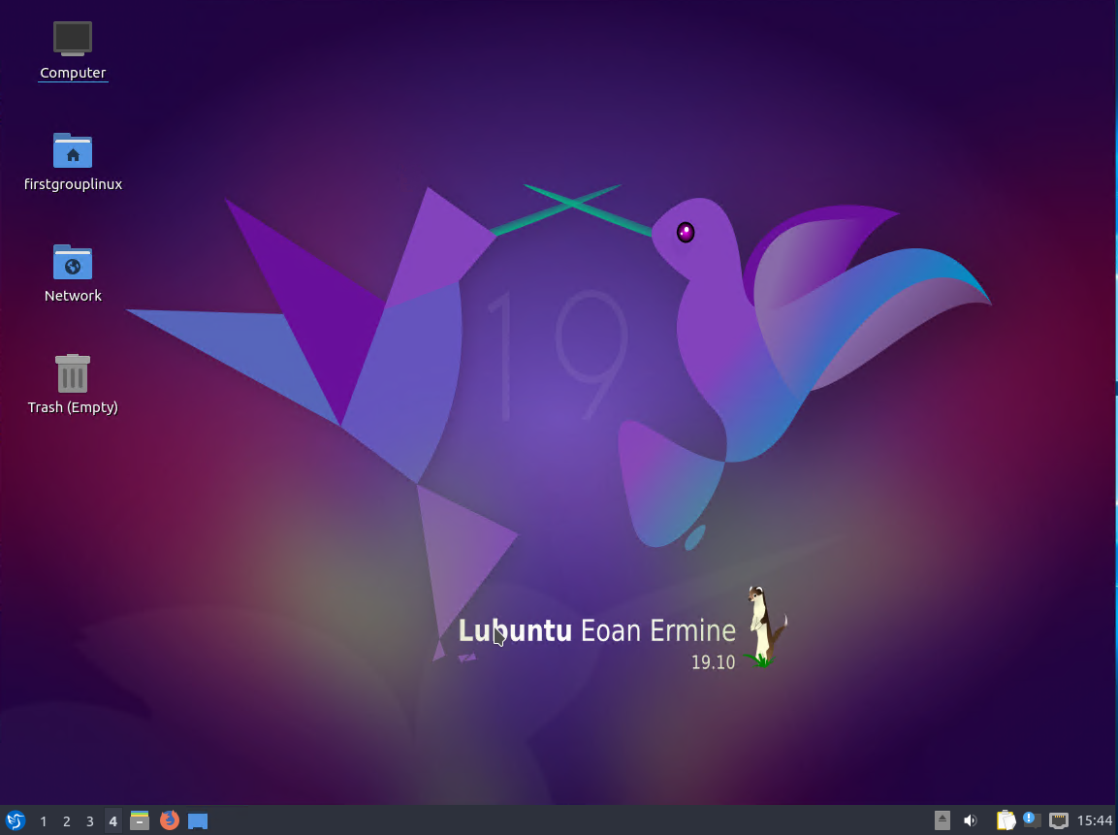
Linux
Serves only for experimental purposes

Slide 10
Firewall
VPN server
Has several purposes
Proxy server
Router/Firewall

Slide 11
Users, group policies
Users
Group Policies
    Full system control
    Folder redirection
Administrators:
    Admin
    Administrator
    Test
Simpson:
    Homer Simpson
SanAndreas:
    CJ
    BigSmoke
GTA (Unified background picture)
Folder redirection

Slide 12


Application/dashboard
Programming language we used for developing application is Python
For databases we used SQLite

Slide 13
Server environment and application demo

Slide 14
Questions?

Slide 15
Thank you for your attention

